Slide 1

PreseNtation
Topic :- prepardness in pre,during and post disaster management
COURSE TITLE :- DISASTER MANAGEMENT
COURSE NO :- ALWM-311
CREDIT HOURSE :- 2(1+1)
YEAR /SEMESTER :- 3rd YEAR /1ST SEMESTER
PRESENTED BY –
Naveen Kumar
Ankita Chauhan
Surbhi Varma
Megha Kashyap
SUBMITED TO-
Sh. J. L. SALAM
(course teacher)

Slide 2
DISASTER
dEFINATION:- “DISASTER IS A SUDDEN CALAMITOUS EVENT BRINGING GREAT DAMAGE, LOSS, HUMAN MATERIAL OR ENVIRONMENTAL LOSSES AND DESTRUCTION, DEVASTATION TO LIFE AND PROPERTY.”

Slide 3
Effect of Disaster
Loss of life .
Injury on health.
Epidermiological threat.
Loss of crops.
Looss of housing.
Loss of industrial production.
Loss of business.
Loss of national economic.
Disruption to governmental system.
Disruption of marketing system.
Disruption of environment.
Disruption of property.
Disruption of communications.
Disruption of transport.
Breakdown of social order.

Slide 4
Disaster management
DEFINATION:- “Disaster management is a multidisciplinary area in which a wide range of issues that rang
21.e from forecasting, warning evacuation, search and rescue, relief, reconstruction and rehabilitation are included.”

Slide 5
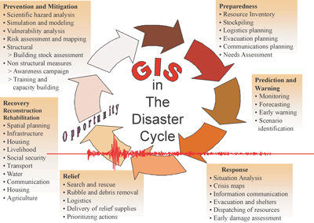

Slide 6
PREPAREDNESS IN, PRE, DURING, AND POST .
PREPAREDNESS – PRE PLANNING OF ANY EVENT.
Preparedness is a part of pre disaster management.
TYPES OF DISASTER MANAGEMENT-
1.Pre condition- evacuation
2.Post operation-rescue

Slide 7
DISASTER MANAGEMENT CYCLE
Pre disaster-
Mitigation,
Preparedness, &
Emergency response activities.
During disaster-
Response,&
Recovery activities.
Post disaster-
Immidiate searching operation,
Provide food materials,
Medical facilities,
Rehabitation,
Migration,&
Reconstruction.

Slide 8
DISASTER
NATURAL
MANMADE
1.MAJOR NATURAL DISASTER:-
FLOOD, LANDSLIDE, DROUGHT, CYCLONE, TSUNAMI, EARTHQUAKE.
2. MINOR NATURAL DISASTER:-
COLD WAVE, THUNDERSTORMS, HEAT WAVE, MUDSLIDES STORMS, ETC.
1.MAJOR MANMADE DISASTER:-
SETTING OF FIRES, EPIDEMICS, DEFORESTATION, POLLUTION, WARS. ETC
2.MINOR MANMADE DISASTER;-
ROAD&TRAIN ACCIDENTS, FOOD POISINING, INDUSTRIAL DISASTER, ENVIRONMENTAL POLLUTION, ETC.

Slide 9
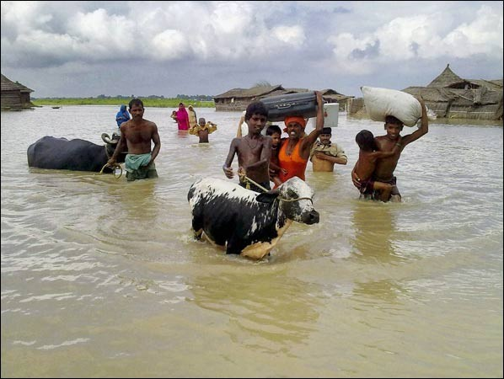
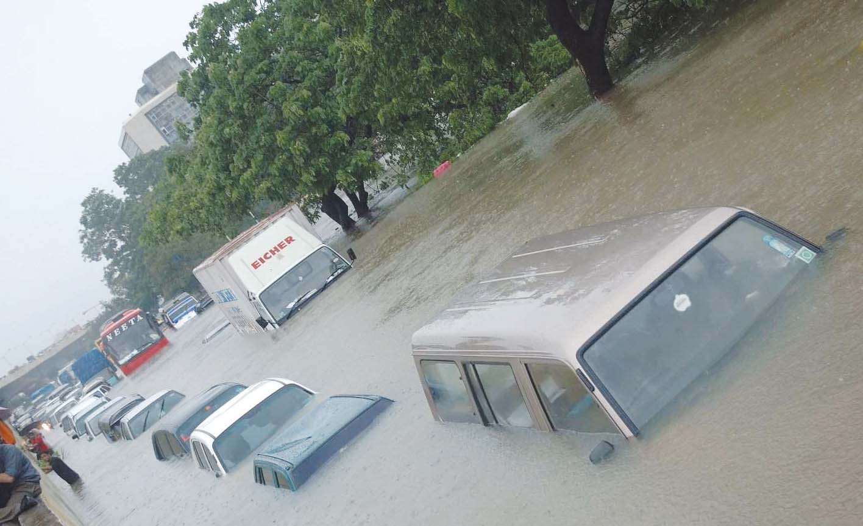
flood

Slide 10
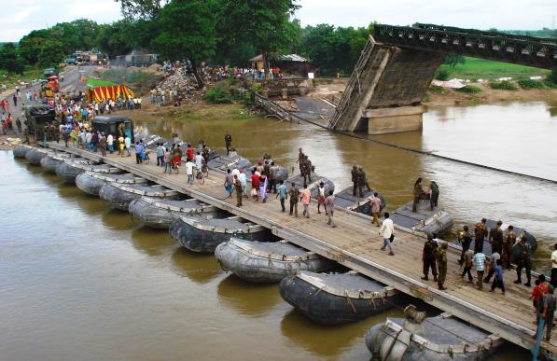
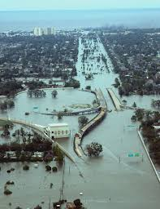
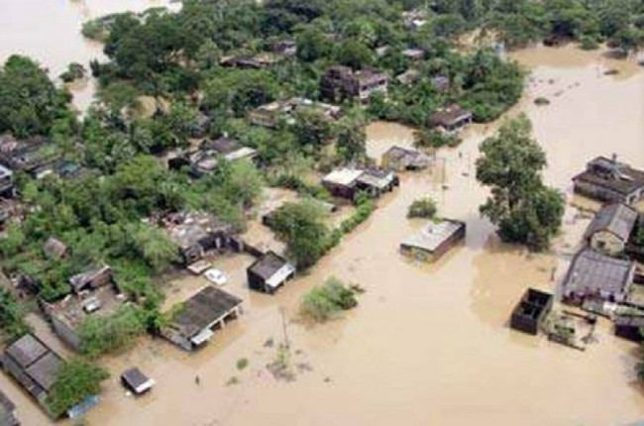
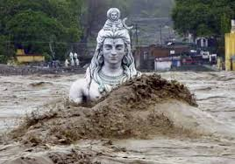

Slide 11
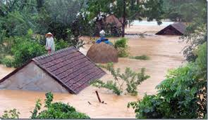
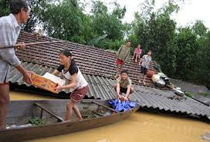
HELP
Supply food materieals

Slide 12
PREPAREDNESS IN FLOOD
PRE-FLOOD-
Forecasting according to seasonal pattern, drainage basin capacity, flood plain mapping, and air and land surveys.
Flood control measures would include provision for dams, disks channel, flood proofing,erossion control.
All your family member should know the safe route to nearest shelter raised safe (pacca) house.
Have an emergency kit .
Land use control.
Crop insurance.

Slide 13
DURING-FLOOD-
Drink boiled water
Keep your food material, don’t take heavy meals
Use raw tea, rice water, tender coconut water etc.
Use bleaching powder.
Help the official or volunteer distributing relief material.
Food detection and warning systems.
Community education.
Development of master plan for flood plan management.

Slide 14
POST FLOOD:-
Search and rescue, medical treat.
Disaster assessment.
Short term food and water supply.
Water purification.
Epidemiological surveiliance.
Maintaining wet land.
Food forcosting and warning services.
Public health measures etc.

Slide 15

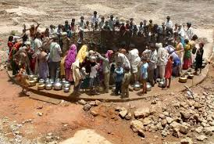
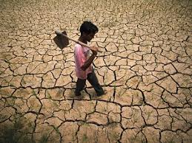
“DROUGHT COMES IN THE GENERALY DRY SEASON”

Slide 16
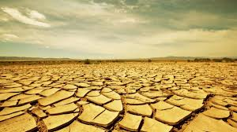
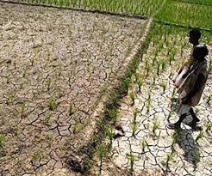
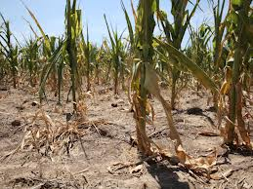
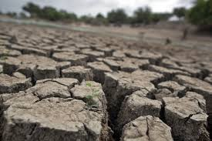
PERMANENT DROUGHT
SEASONAL DROUGHT
ATMOSPHERIC DROUGHT
HIGH TEMPERATURE

Slide 17
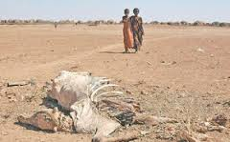
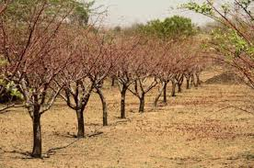
DROUGHT HAZARDS
HIGH TEMPERATURES
HIGH TEMPERATURES
LOSS OF SOIL MOISTURE
VERY LOW HUMIDITY
DEATH OF ANIMALS
LOSS OF FOREST
ECONOMIC LOSSES
REDUCTIONS IN WATER QUANTITY AND QUALITY

Slide 18
DROUGHT MANAGEMENT
Long-term mitigation strategies
Public information and education campaigns
Construction of community based rain water harvesting structures
Promoting watershed programmes.
Increasing forest cover through plantation.
adopting drought resistant variety of paddy and other crops.
Using alternative crops in drought condition
Encouraging crop and seed insurance schemes

Slide 19
Post management
Improvements in water systems
(for example, leak detection, lining of transmission canals)
Emergency sources of supply
(for example, emergency interconnections, drilling new wells)
Management of available water resources
(for example, emergency water banks, over drafting of groundwater aquifers)
Search for new supplies of water

Slide 20
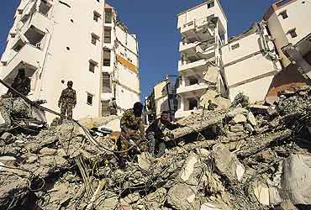
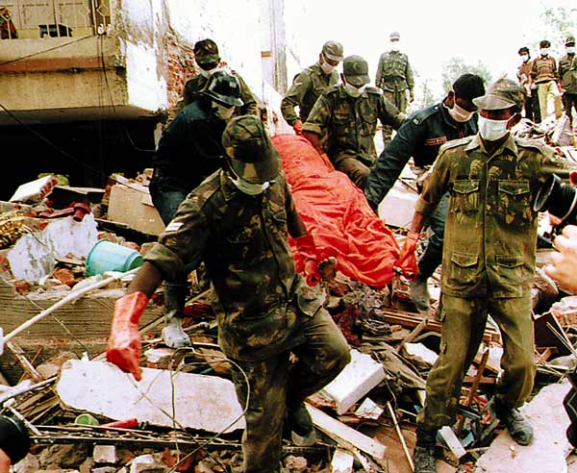
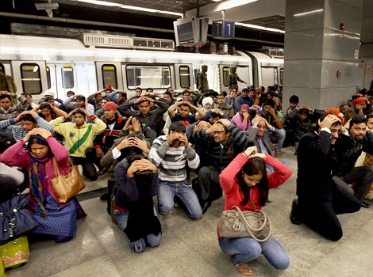
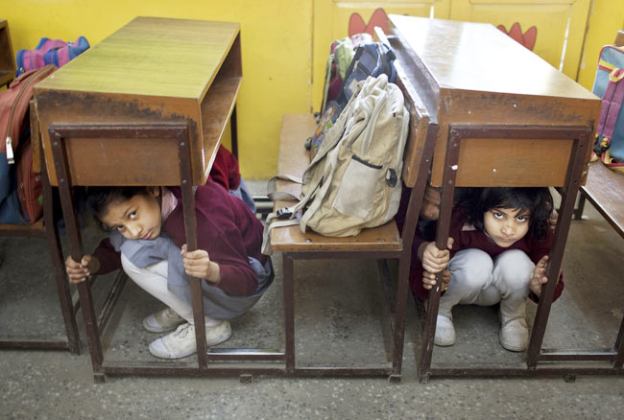
EARTHQUAKE

Slide 21
EARTHQUAKES
PRE-EARTHQUAKE-
Weather forecasting (seismic activity,historical incidense,& observations)
Always keep the following in a designated place,bottled drnking water , non perishable food, first aid kit, torch light and battery operated radio with extra batteries.
Teach family member to how to turn of electricity and gas etc.
Identify places in the house that can provide cover during an earthquake
Public awaredness programmes and training.
Make the building resistance for earthquake.
Insurance.

Slide 22
DURING-EARTHQUAKE.-
Take cover to go under a table or other furniture.
Do not run outside , if you are inside.
Never use the lift.
Do not re-enter in damaged buildings & stay away from badly damaged structures.
Identify an out of town relative /friend as our familys emergency contact.
The best thing to do is to move the open area where there are no tree, elecric ,telephone wire.

Slide 23
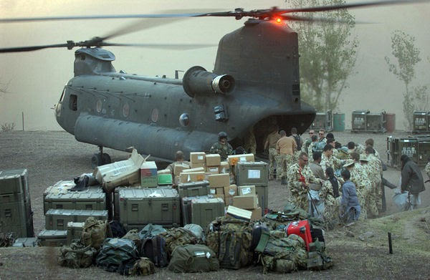
FOOD MATERIAL SUPPLY

Slide 24
POST EARTHQUAKE=
Search and rescue measure.
Emergency medical assistance ,food materials.
Relif assistance.
Repair and reconstruction.
Economic recovery.
Earthquake warning and preparedness programmes.
Radio,TV,News .

Slide 25

LANDSLIDE

Slide 26
LANDSLIDES
PRE-LANDSLIDE MANAGEMENT-
Areas of high risk determined by use of information on area geology, geomorphology, climatology and vegetation.
Community education.
Avoid to live in building with weak foundations.
Avoid the use of brittle pipe lines.
Avoid the buried pipeline.
Increasing vegetations and plantation of deep rooted plants .
Retaining walls.
Road construction away from prone areas.
Avoid forest fire.
Construction of drainage channels.
Crop insurancce.
Control soil erosion.

Slide 27
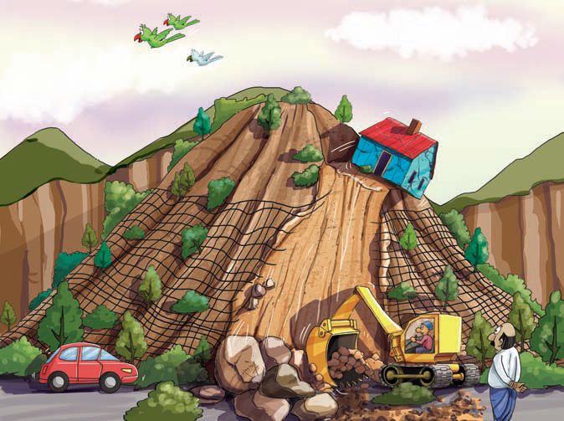

Slide 28
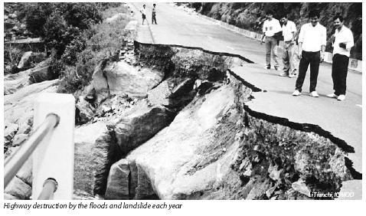
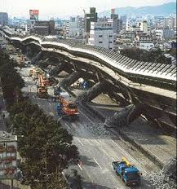

Slide 29
DURING LAND SLIDE-
Move to nearest levelled areas.
Immediately barrier formation to completely checking the travelling.
In rainy days the travelers must be attain their focus to alternate route(path).
Installation of early warming system.
POST-LAND SLIDE-
Search and rescue operations.
Check injured person.
Use of earth removal equipments.
Emergency shelter for homeless.
Listen to local radio and telivision stations for latest emergency information.

Slide 30

TSUNAMI

Slide 31
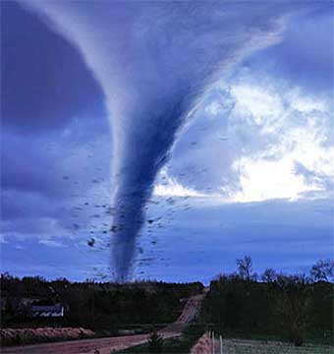
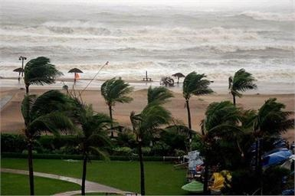
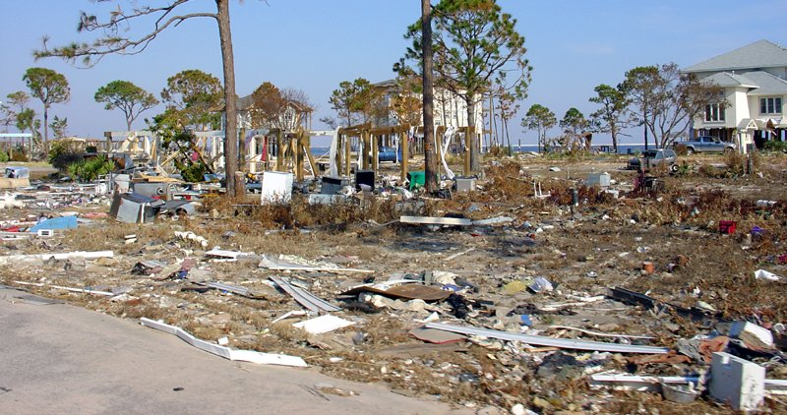
TSUNAMI

Slide 32
TSUNAMI
PRE -TSUNAMI MANAGEMENT-
Community education.
Establishing warning system.
Hazard mapping, planning evacuation routes.
Avoid location of settlements in low laying coastal region.
Creation of tsunami resistant buildings.
Timely warning system and evacuations.
Building barriers such as breakwater.
DURING-TSUNAMI MANAGEMENT-
Moved the injuries people are septy area.
Make availability of drinking water.
Tsunami warming system, Radio, TV, information.
Help of peoples ,those are present around water areas by using air services.

Slide 33
POST-TSUNAMI MANAGEMENT-
Warning and evacuations.
Search and rescue.
Medical assistance.
Emergency food materials supply.
Disaster assessment.
Provide food security.
Management of shelter places.
Time to time evaluation of warning system.

Slide 34
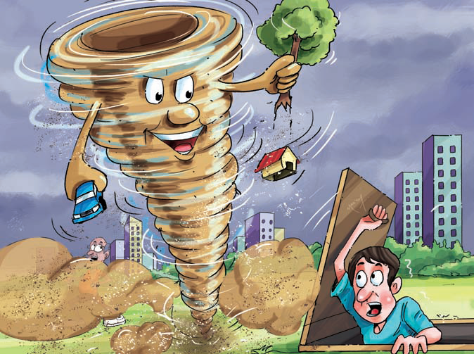
CYCLONE

Slide 35
CYCLONES
PRE-CYCLONE MANAGEMENT-
Keep watch on weather and listen to radio and TV. keep alert about the community warning system .
Prepare an emergency kit .
Check the roof and cover it with net or bamboo.
Check the wall, pillar ,door, and window to see if they are secure.
If your area is prone to storm ,surge locate safe ground and shelter .
Keep important documents.
DURING-CYCLONE MANAGEMENT
Do not allowed the fish capturing.
Do not allowed the boating.
In case of serious storms ,move with your family to a strong building.
Wear strong shoes and cloths for protections ,lock your home, switch off power gas, and take emergency kit.

Slide 36
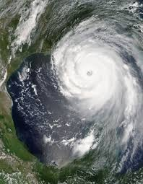
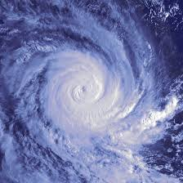

Slide 37
POST-CYCLONE MANAGEMENT-
Evacuation and emergency shelter.
Search and rescue.
Medical assistance.
Water purification .
Re-establishment .
Legislation and communication network.
Disaster assessment.
Do not go out side until officially advice it is safe.
Check for gas leak, do not use electrical appliances, if wet
Listen to local radio for official warning and advice..
Beware of fallen power line ,damaged bridge, buildings, and tree and do not enter the flood water.

Slide 38
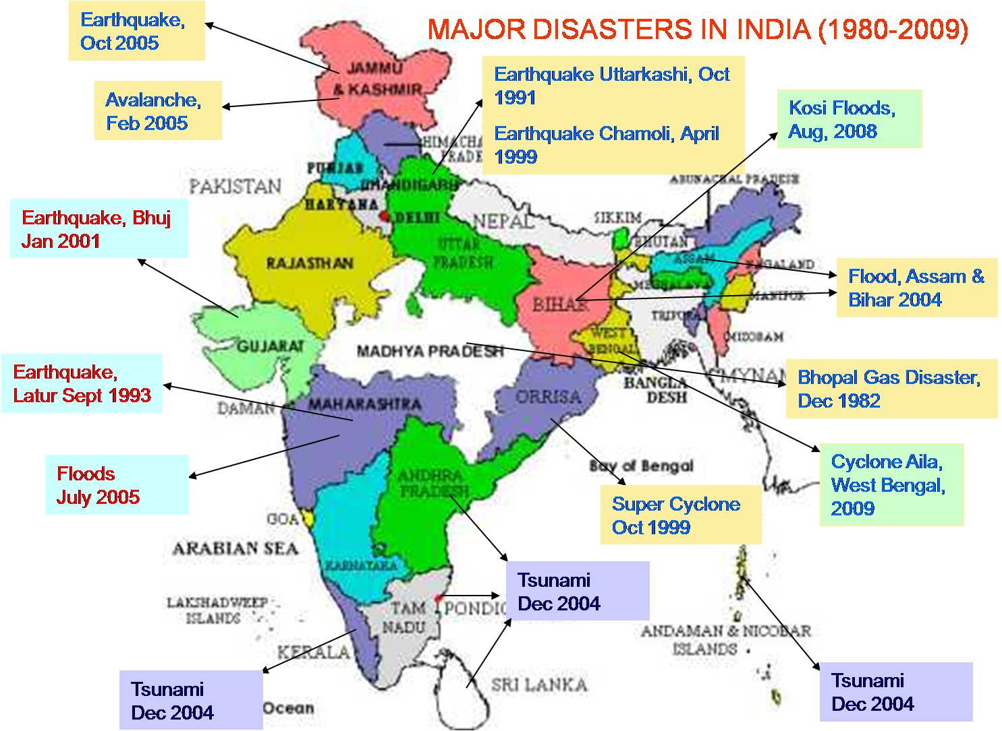

Slide 39
THANK YOU

